Slide 1
Kubernetes on Azure
Brief overview

Slide 2
Sia Ghassemi
Founder sia consulting
Cloud Consulting
Cloud Development
Cloud Security
Blockchain Consulting
Domain modeling
Trainings
Event sourcing enthusiast
Microsoft MVP
Love DDD
Speaker at conferences and meetups

Slide 3
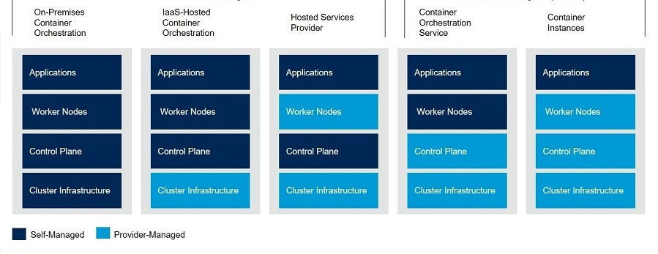
Container as a Service

Slide 4
Container as a Service
Notes:
OCI = Open Container Initiative

Slide 5



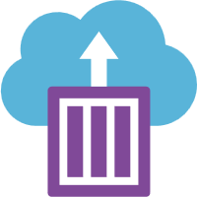

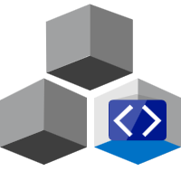
Container ServiceS on Azure
Web App for Containers
Container Monitoring
Container Registry (ACR)
Container Instances (ACI)
Kubernetes Service (AKS/ACS*)
Azure DevSpaces
Web App for Containers
Container Monitoring
Container Registry (ACR)
Container Instances (ACI)
Kubernetes Service (AKS/ACS*)
Azure Dev Spaces
Notes:
OCI = Open Container Initiative

Slide 6
Azure Container Registry
Store Docker images
Store Helm Templates
Store OCI Artifacts
Auto update based on Triggers
Auto update based on base-image
Geo replication
Complete task base build-system (CI/CD)
Schedulable
On-Demand
Auto deploy to Azure Container Instances
Notes:
OCI = Open Container Initiative

Slide 7
Azure Container Instances
Lightweight container solution
Simply run containers in Azure
Basis for Azure Virtual Kubelets
Event driven scheduling
Public IP address

Slide 8
Azure Kubernetes Service
Managed Kubernetes Service
Auto provisioning of Azure resource on demand
Support for Virtual Kubelets
Virtual nodes and virtual pods
Support for multiple-node-pools
Mix linux and windows containers
Autoscaler for Nodes and Pods
Event driven scaling with KEDA
Integrated Ingress-controller
Basic Http-Routing
Azure Application Gateway
External DNS
Integrated Identity
Azure Active Directory

Slide 9
Demo

Slide 10

Azure Dev Spaces
Azure Dev Spaces provides a rapid, iterative Kubernetes development experience for teams in Azure Kubernetes Service (AKS) clusters. Azure Dev Spaces also allows you to debug and test all the components of your application in AKS with minimal development machine setup, without replicating or mocking up dependencies.

Slide 11
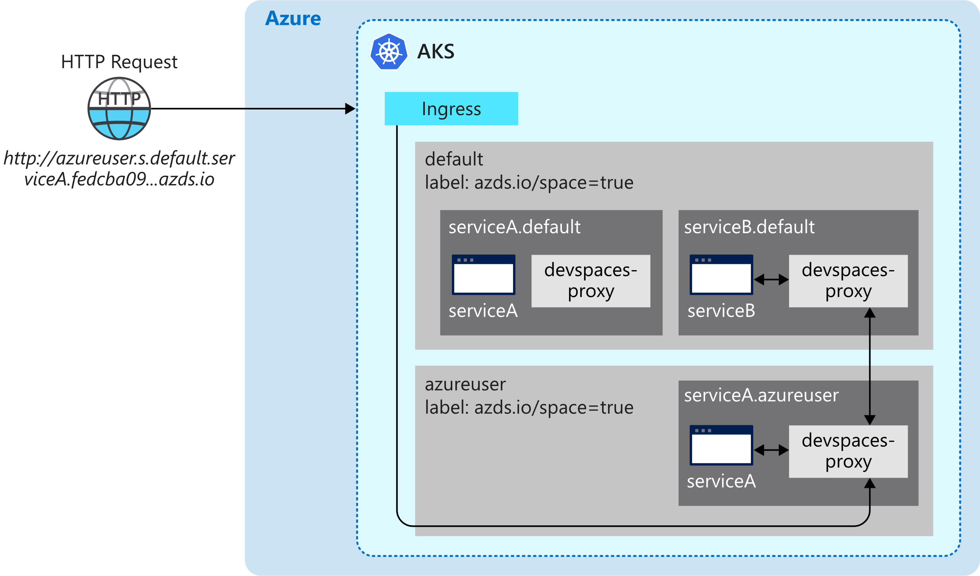
Azure Dev SPaces

Slide 12
Azure Dev Spaces

Slide 13
Azure Dev spaces
Deploys Susi’s debug version of service the Bike Kubernetes
When Susi debugs her service, calls to the service are redirected to her IDE
Meanwhile John debugs his version of the Reservations service without interrupting Susi’s work
DevSpaces deploys the service right out of the IDE to Kubernetes and stream stdin and stdout to the IDE and attaches the debugger

Slide 14
Azure Dev SPaces

Slide 15
Azure Dev spaces
Using Kubernetes namespaces for separation
Support for inheritance
Static assets are directly update on the running container
Source code changes are built and app is restarted in running container
Kubernetes config changes are applied and container is restarted

Slide 16
Demo

Slide 17
Thank you

Slide 18
Resource ACR
Overview: https://azure.microsoft.com/en-us/services/container-registry/
Docs: https://docs.microsoft.com/en-us/azure/container-registry/container-registry-intro
SKUs and limits: https://docs.microsoft.com/en-us/azure/container-registry/container-registry-skus
OCI: https://www.opencontainers.org/

Slide 19
Resources ACI
Overview: https://azure.microsoft.com/en-us/services/container-instances/
Docs: https://docs.microsoft.com/en-us/azure/container-instances/container-instances-quickstart
Quotas and limits: https://docs.microsoft.com/en-us/azure/container-instances/container-instances-quotas
Virtual Kubelet: https://virtual-kubelet.io/

Slide 20
Resources AKS
Overview: https://azure.microsoft.com/en-us/services/kubernetes-service/
Docs: https://docs.microsoft.com/en-us/azure/aks/
Quotas and limits: https://docs.microsoft.com/en-us/azure/aks/quotas-skus-regions
KEDA: https://github.com/kedacore/keda

Slide 21
Resources Dev Spaces
Overview: https://docs.microsoft.com/en-us/azure/dev-spaces/
Docs: https://docs.microsoft.com/en-us/azure/dev-spaces/quickstart-team-development
How it works: https://docs.microsoft.com/en-us/azure/dev-spaces/how-dev-spaces-works

Slide 22
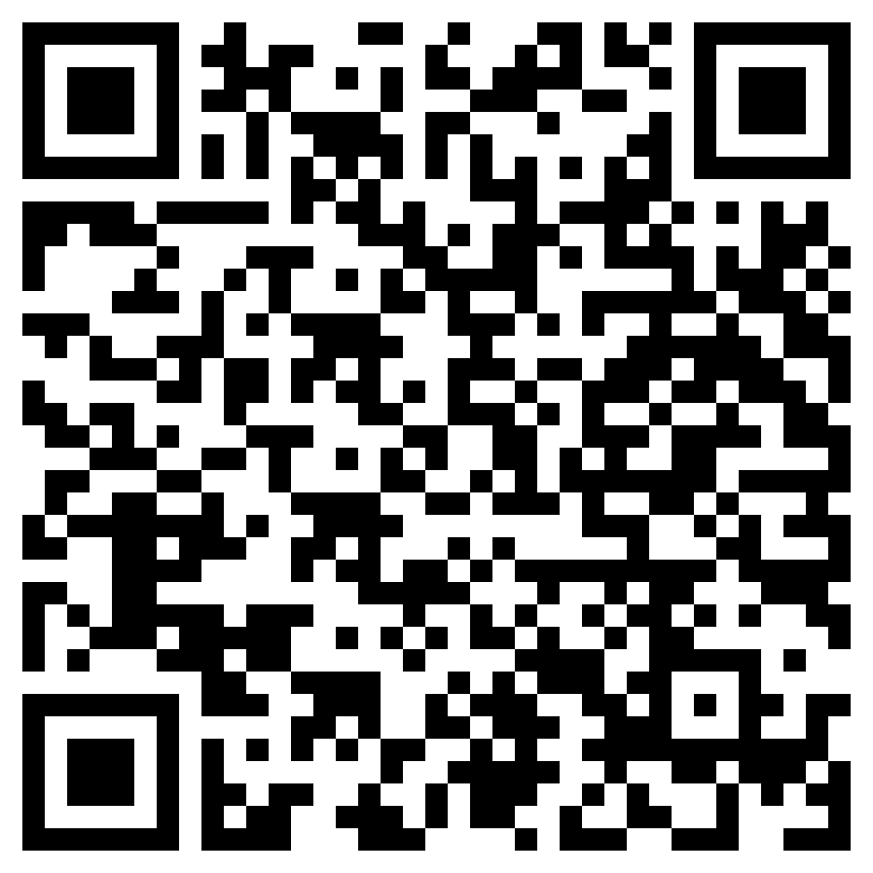
Link to slides

